Slide 1
Types of Learning
in Deep Learning:-

Slide 2
As usually there’s three types of Learning:-
Supervised Learning.
Unsupervised Learning.
Reinforcement Learning.

Slide 3

Supervised Learning:-
Supervised Learning is the process where it’s in learning process. It means someone training at that point of time or we can say there’s a supervisor available who train or gives knowledge.
Example:- As it showing in picture she’s training baby about Toys or how to play the game.

Slide 4
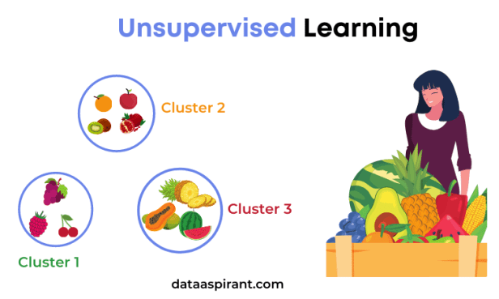
Unsupervised Learning:-
Unsupervised Learning is the process when there’s not any supervisor available for training or there’s not any label (pre data). In this process there’s not able to grab the knowledge by themself about new things. In Unsupervised Learning there’s not pre-knowledge available. It works on basis of clustering and classifying the information.
Example:- As in this picture showing if we give a bucket of fruits to the person and ask to do the differentiate so it’ll happen basis on classification or clustering.

Slide 5
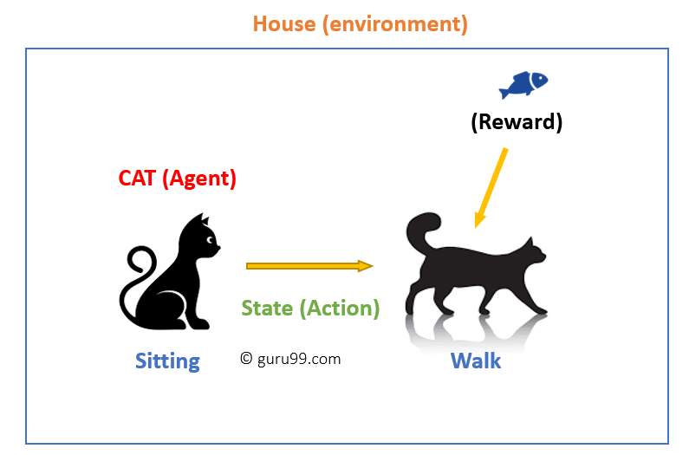
Reinforcement Learning:-
Reinforcement Learning is the process new things come it check the existing data it may be (supervised or unsupervised) and then act according to that.
In Reinforcement it learn to act based on feed form/ reward.
Example:- It acts according to new things based on exist data then get result whether reward or loss.

